Slide 1
EXCHANGE RATES
Name
Institutional Affiliation
Course
Date

Slide 2
Introduction
In general, goods, services, and assets produced in a country must be paid for in that country’s currency.
Foreign Exchange Market
  International transactions require a market in which currencies can be exchanged for each other.
Exchange Rates
  The prices at which currencies trade, as determined by the foreign exchange market.

Slide 3
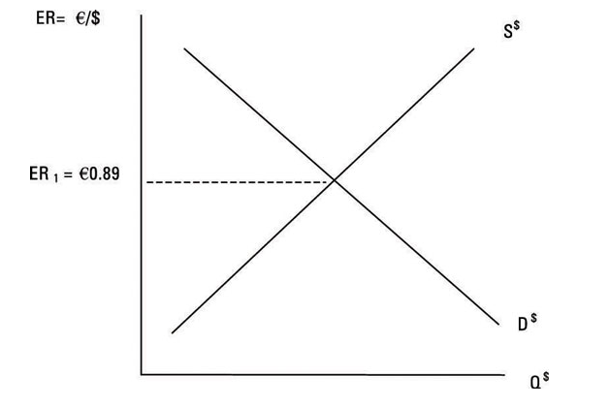
How Supply and Demand Determine Exchange Rates
The Demand for and Supply of U.S. Dollars
Market equilibrium occurs where the demand for U.S. dollars equals the supply.

Slide 4
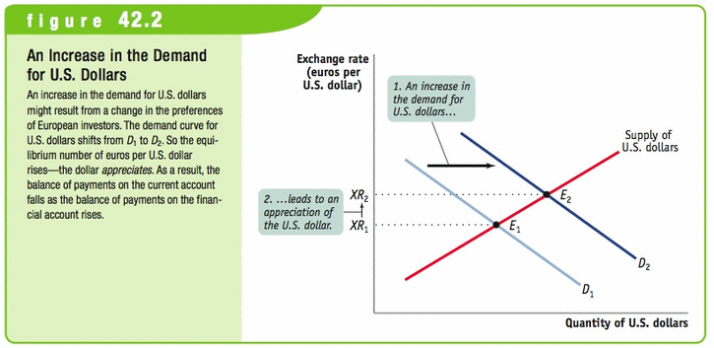
Changes in Demand or Supply
Shifts in the Demand for U.S. Dollars
An increase in the demand for dollars will increase (appreciate) the dollar’s exchange rate
Higher U.S. interest rates or lower U.S. prices will increase the demand for dollars

Slide 5
Causes in the shift in the Demand for Dollars
  Changes in disposable income
  Trade restrictions
  Perceptions of economic stability
  Changes in real interest rates
  Changes in relative prices of goods
  Changes in product preferences

Slide 6
Role of Exchange Rates

Slide 7
Role of Exchange Rates
Increase in real interest rates in the United States causes an increase capital inflow into the U.S
  Appreciation of the dollar makes U.S. exports relatively more expensive.

Slide 8
The Equilibrium Exchange Rate
Movements in the exchange rate ensure that changes in the financial account and in the current account offset each other
Dollar appreciates=financial account increases
  Foreigners buy less American goods (current account decreases)
Dollar depreciates=current account (net exports) increase
  Foreigners buy more American goods (current account increases

Slide 9
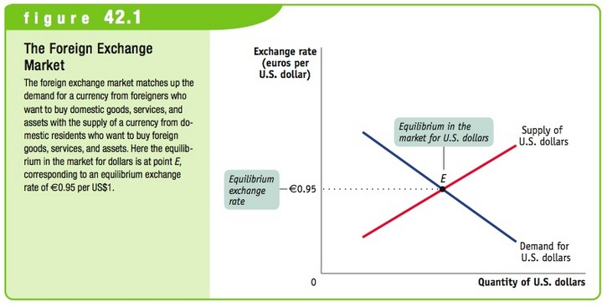
The Equilibrium Exchange Rate
The exchange rate for any currency is determined by the supply of that currency and the demand for that currency

Slide 10
The Equilibrium Exchange Rate
Depreciation
  An decrease in the exchange value of one nation’s currency in terms of the currency of another nation
Appreciation
  An increase in the exchange value of one nation’s currency in terms of the currency of another nation

Slide 11
Exchange Rate Regime
Exchange Rate Regime
  A rule governing policy toward the exchange rate
  There are two main kinds of exchange rate regimes
Fixed Exchange Rates
  When government keeps the exchange rate against some other currency at or near a particular target.
Floating Exchange Rates
  When government lets the exchange rate go wherever the market takes it.

Slide 12
Exchange rate risk
Exchange rate risk, is the financial risk arising from fluctuations in the value of a base currency against a foreign currency in which a company or individual has assets or obligations
To offset exchange rate risk, foreign exchange risk management strategies, which involve hedging currency exposures using financial derivatives such as forward contracts, futures or options.

Slide 13
References
Betts, C. M., & Kehoe, T. J. (2006). US real exchange rate fluctuations and relative price fluctuations. Journal of Monetary Economics, 53(7), 1297-1326
Dominguez, K. M., & Tesar, L. L. (2006). Exchange rate exposure. Journal of international Economics, 68(1), 188-218

